Slide 1


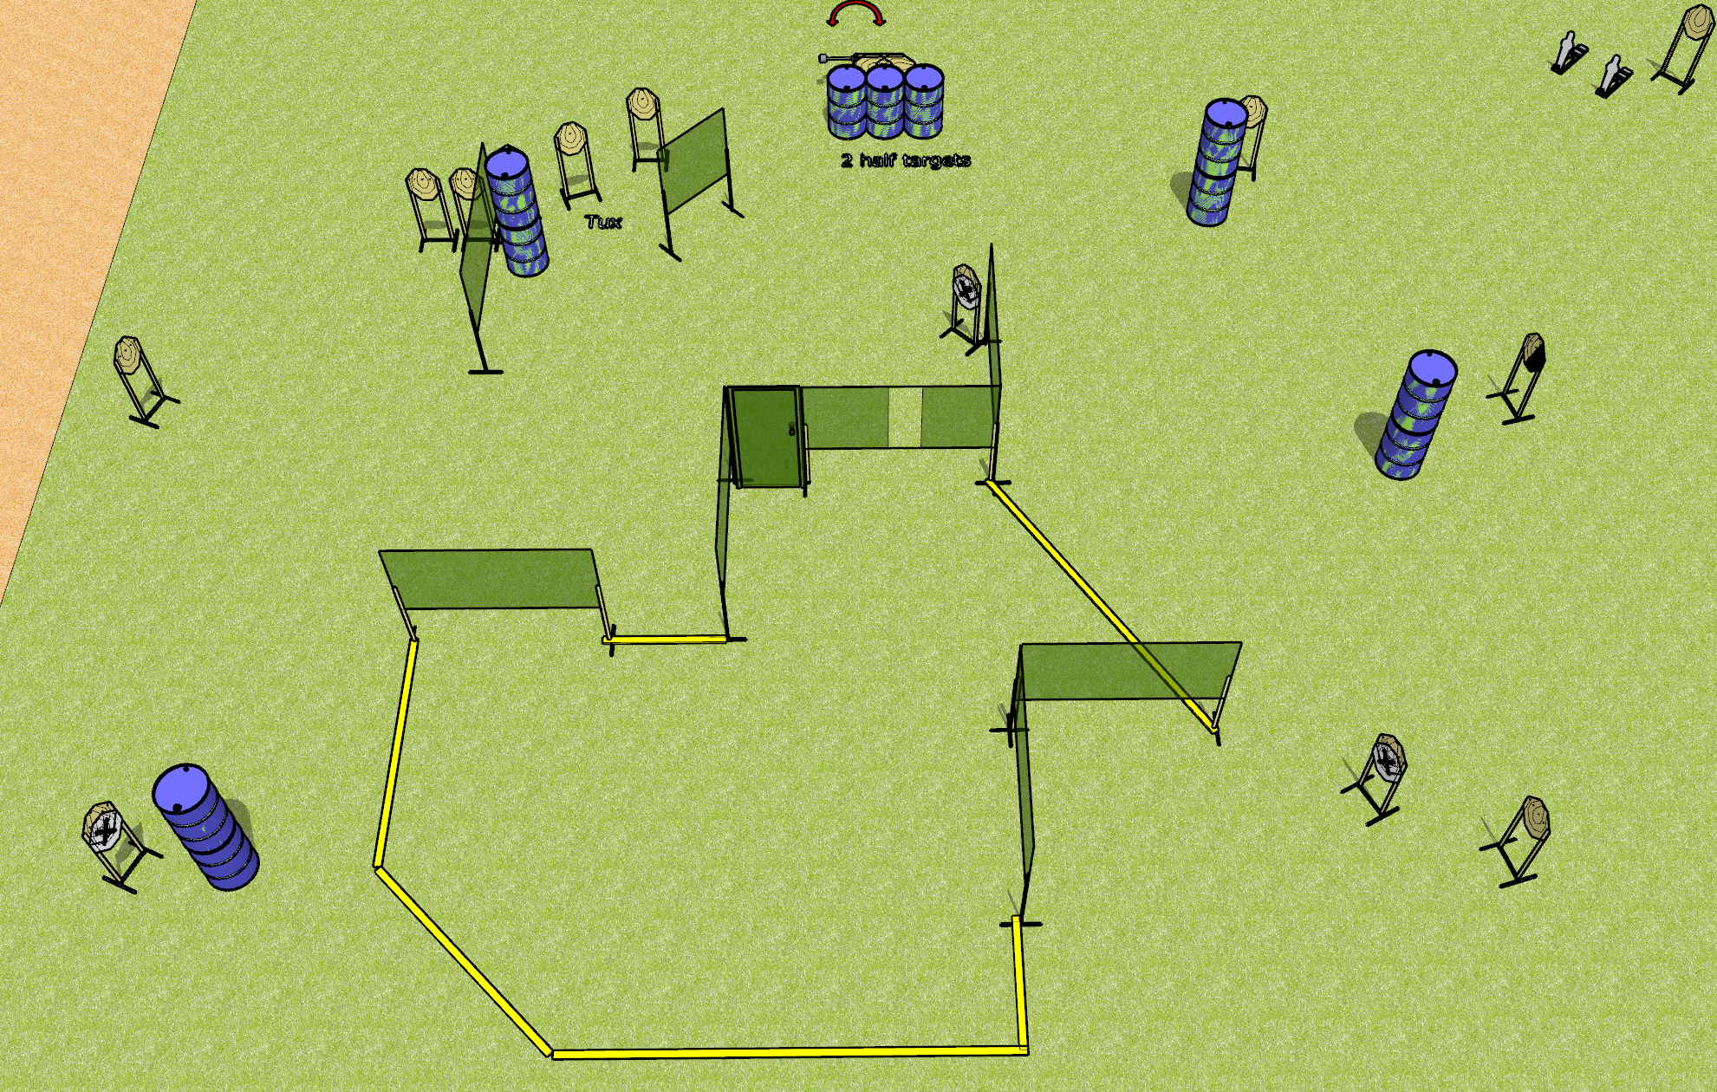
 | Dothan Gun Club – USPSA Match Whole Lotta Nothing Course Designer : Drew Coleman
Round Count 32 rounds 15 IPSC 2 mini poppers
Equipment List 2 medium fault lines 14 wall feet 1 swinger + 1 door + activator 1 tux + 1 right diag + 2 cut in half 14 targets (11 + 3 NS)

Slide 2
Whole Lotta Nothing
Written Stage Briefing
Whole Lotta Nothing is a 32 round, 160 point, Comstock course of fire. There are 15 IPSC targets and 2 mini poppers. The best 2 hits on paper will score and steel must fall to score.
The swinger is activated by the door and remains visible at rest.
Handgun start position is inside shooting area, wrists below belt. Handgun is loaded and holstered.
PCC start position is inside shooting area, stock on belt. Loaded carbine is held with both hands, safety on.
On the audible start signal, engage targets as they become available from within the shooting area.

